Slide 1
Denver Solid Waste Management Expanded Services and New Fee August 2022

Slide 2
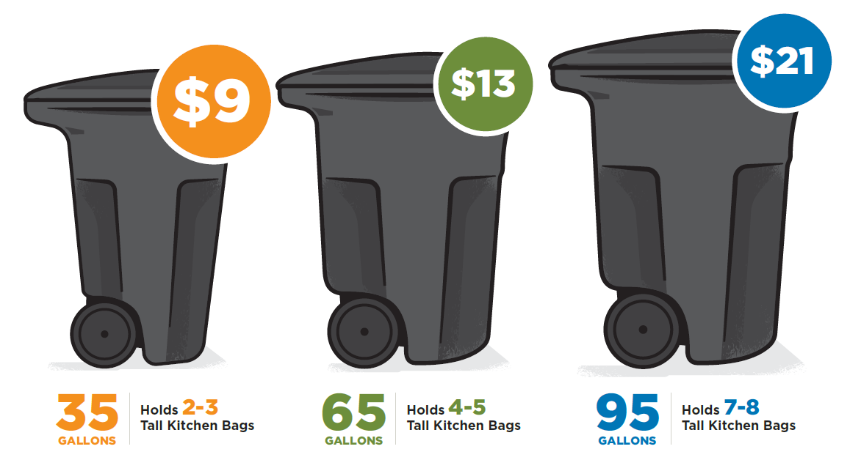
Changes to Denver’s Services
New fee based on trash cart size, recycle and compost included at no additional cost.
Who:
180,000 customers
Single family homes & apartments up to 7 units.
Adding compost service to ~150k new homes
Weekly recycling

Slide 3
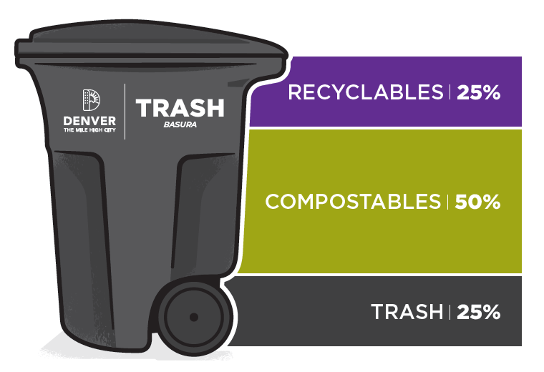
Why Volume-Based Pricing?
74% of Denver’s waste currently goes to the landfill:
26% diversion rate (recycling + compost).
50% of trash is compostable.
Adding service to ~150k new homes

Slide 4
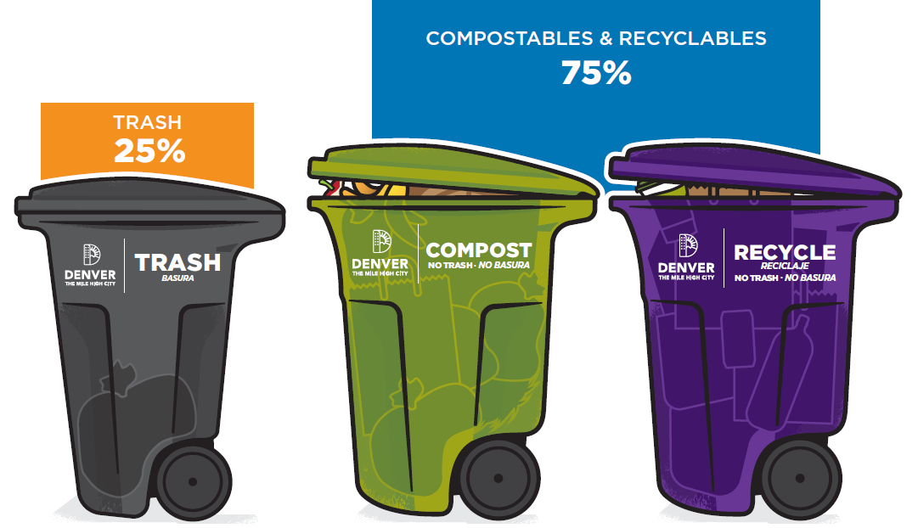

Slide 5
Trash Cart Sizes & Monthly Rates
Recycle and compost carts included at no additional cost.

Slide 6
Services Included:
Weekly recycling!
Weekly composting for all customers!​
Equipment Operators​
Inspectors​
Trucks​
Carts​
Education and Outreach​
Billing System​
Disposal fees
Cherry Creek Drop-off
Extra Trash/Large Item Pick-up
Annual Programs​
Leaf Drop​
Treecycle​
Mulch Give-away​
Subsidized HHW pick up​
Subsidized e-waste drop-off​
Recycle Your Holiday Lights​
Appliance recycling​
Paint recycling​
Great Denver Cleanup
Notes:
These are the services that the fees pay for. As I mentioned before, weekly recycling and compost service for everyone are new. These are also all of the other things that the fees pay for to keep Solid Waste running.

Slide 7
Affordability Program – Instant Rebate
Applications LIVE: Denvergov.org/expandedcollection
Partnership with DHS.
Eligibility = income + number of people in the house (Area Median Income)​:
30% AMI = 100% instant rebate​.
50% AMI = 75% instant rebate​.
60% AMI = 50% instant rebate.

Slide 8
Education and Outreach
Look out for your WasteWise newsletter!
Invite us to your neighborhood events/meetings
Looking for community outreach partners! (Contracted work available)

Slide 9
Program Timeline
NOW
Nov - Dec
Jan – March 2023
Throughout 2023
Rebate application is live.
Education and outreach begins, ask us to present!
Property owners can login online to view. cart sizes, sign up for autopay/e-billing.
Current composters downsize trash carts.
Weekly recycling begins.
Compost cart delivery begins.
Quarterly invoicing begins.
Credits provided for residents without compost service.
Compost cart delivery continues, and service expands in phases citywide.
New composters downsize trash carts.

Slide 10
Compost Roll-out
Compost carts delivered throughout 2023
Delivery includes:
Green compost cart
Kitchen countertop pail
Compostable bags

Slide 11
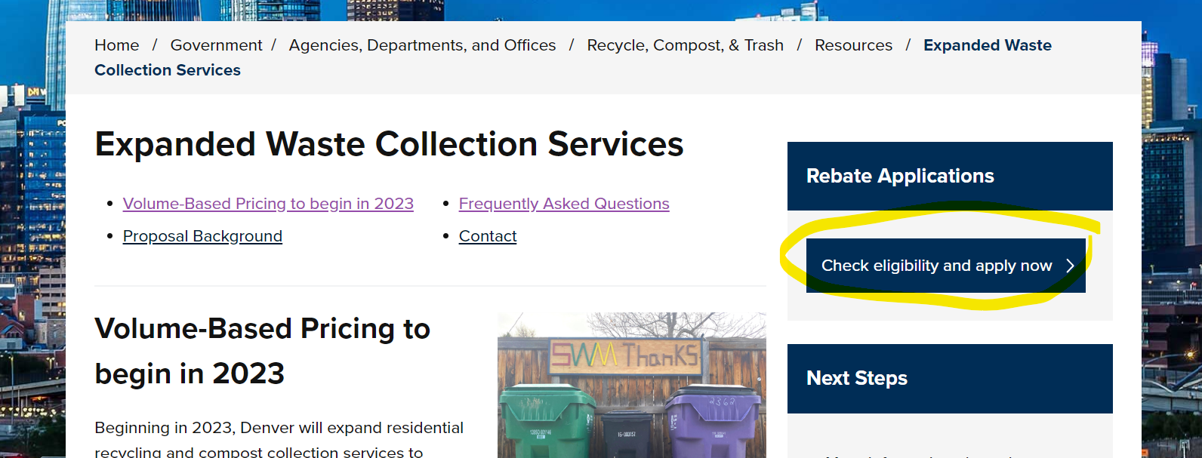
Resources
Denvergov.org/Expandedcollection
Affordability application:
720-944-3350

